Slide 1
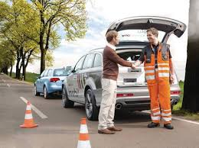
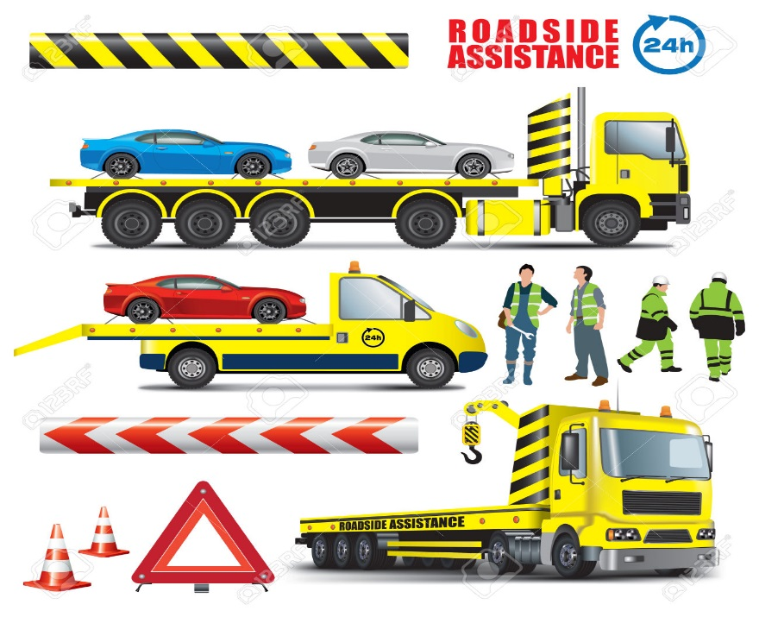
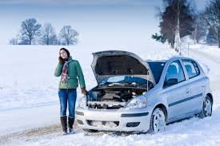
Predict Emergency Roadside Assistance Car Breakdown Call Volume

Slide 2
Data Set
Using the following data
Integrated historical data and public road side events
Data set from NJ DOT
http://www.state.nj.us/transportation/refdata/
Weather Data
http://www.wunderground.com/

Slide 3
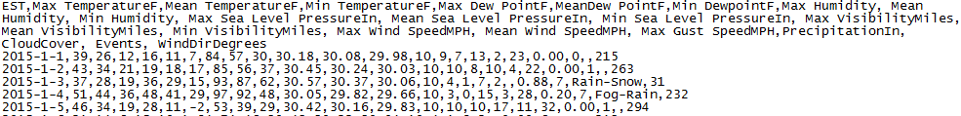
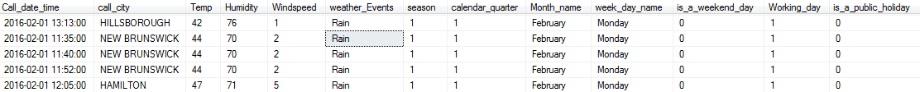
Data Processing and Cleanup
Historical Call volume data set
nn
Weather dataset
Final data set

Slide 4
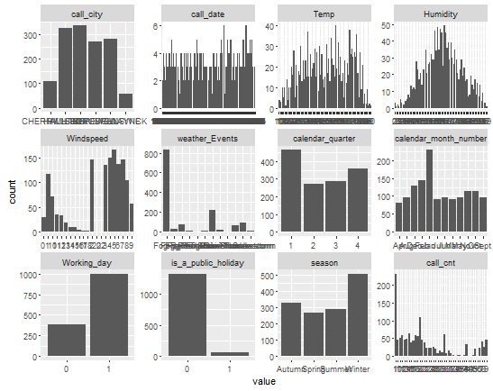
Univariate Variable distributions
There are two cities that have more observations than the rest of the cities.
Humidity, Temp seem to have somewhat ‘balanced’ distributions.
Wind speed seems to be varying throughout the observations.
Weather events has maximum number of calls during one weather event compared to others.
The first quarter seems to have a higher number of observations compared to the other quarters. Similarly, the month of XXXX seems to have a higher number of observations compared to the other months.
Working days seem to have a higher number of observations.
Public holidays have a lesser number of calls than regular days.
Winter season has more number of calls
The outcome variable (call_cnt) seems to be right skewed

Slide 5
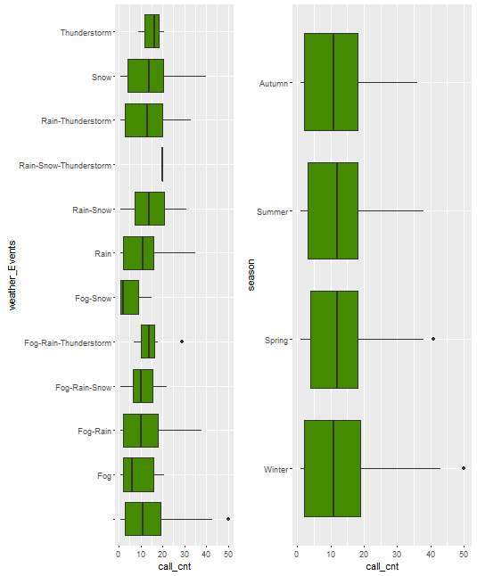
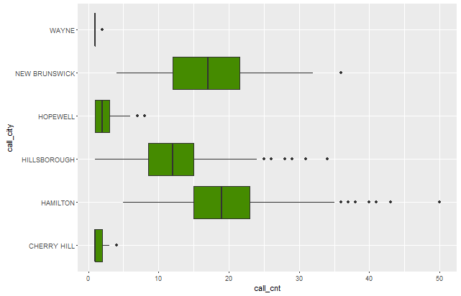
Data distributions
The average call volume for each season seems to be approximately same but the spread of calls during the winter seems to be slightly high compared to the other seasons. But each weather event has different distributions and when the weather event is clear which means no fog, no rain, no thunderstorm and no snow then the call volume is high, because the data from the weather underground has not provided the description for weather events when there is no rain, fog, thunderstorm, or snow.
we can see that Hamilton and New Brunswick cities in NJ have more call volume

Slide 6
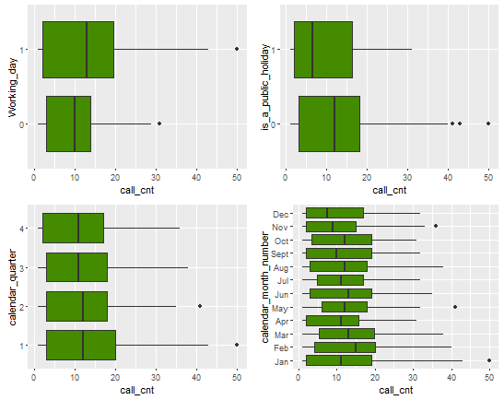
Data distribution of call Volume Vs calendar date
call volume is high during regular days (working and non-holidays).
In January range of call volume is high compared to other months.
February seems to have highest average call volume counts compared to other months.

Slide 7
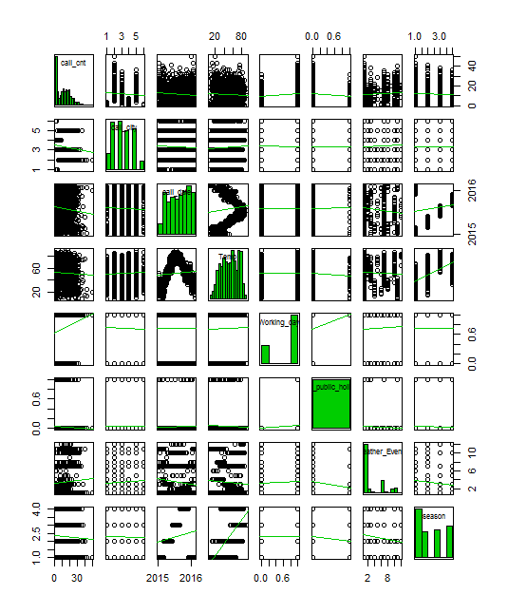
Scatter Plot Matrix

Slide 8
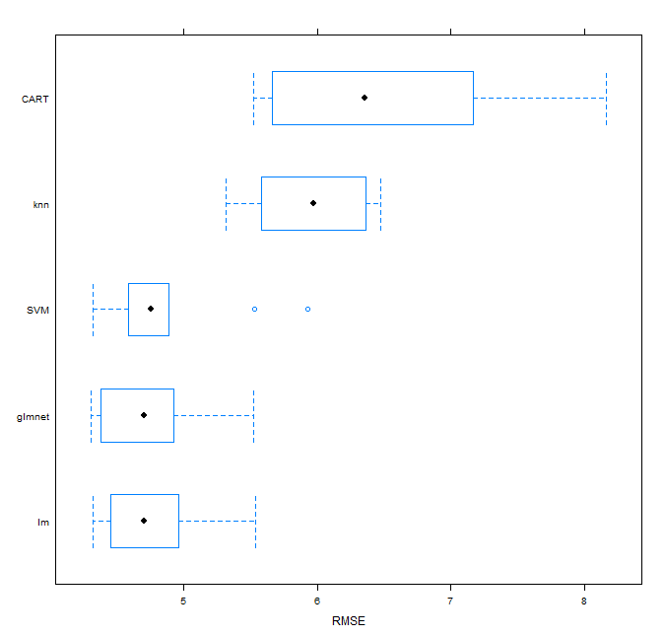
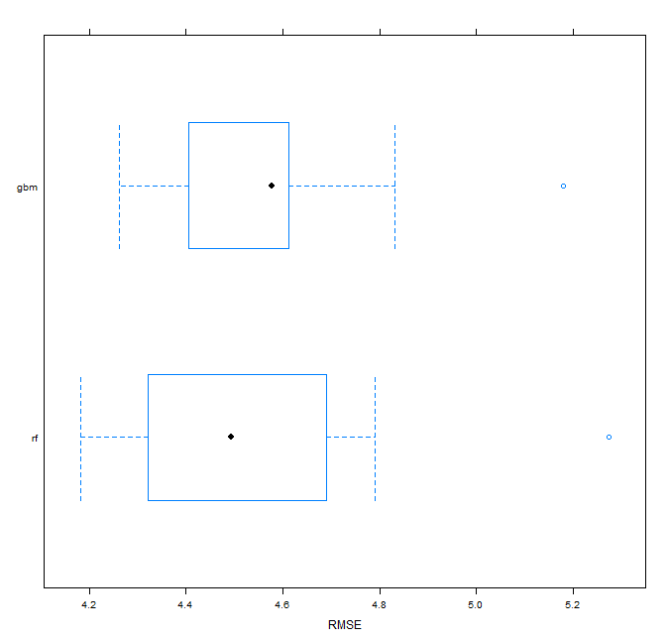
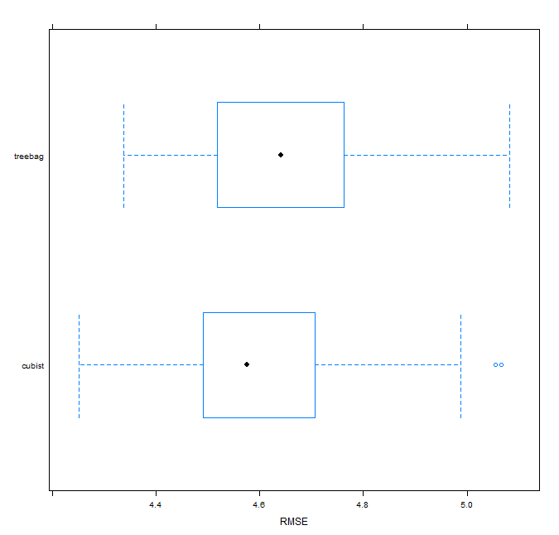
Model Training and Evaluate Algorithms
Algorithm Models | RMSE | Rsquared
glmnet | 4.73 | 0.72
CART | 6.48 | 0.47
SVM | 4.87 | 0.71
Linear regression (lm) | 4.74 | 0.72
K-Nearest Neighbour (knn) | 5.95 | 0.56
Algorithm
 | RMSE | Rsquared
gradiant boosting(gbm) | 4.57 | 0.75
random forest(rf) | 4.54 | 0.75
Algorithm
 | RMSE | Rsquared
cubist | 4.61 | 0.73
treebag | 4.66 | 0.73

Slide 9
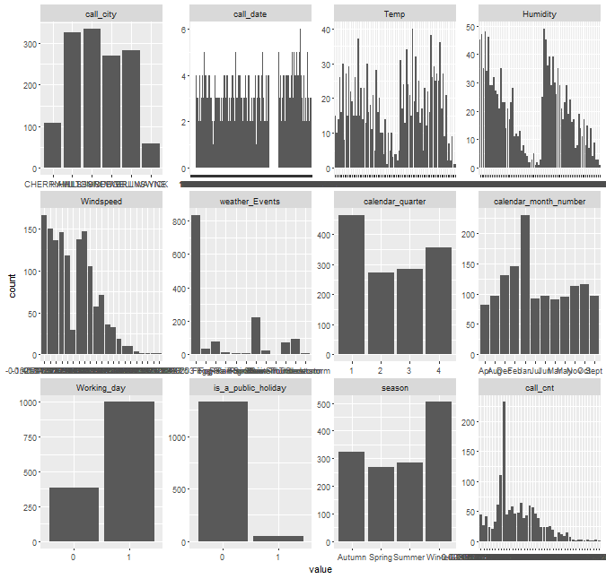
After applying transformation on variables
Algorithm Models | RMSE | Rsquared
glmnet | 4.73 | 0.72
CART | 6.48 | 0.47
SVM | 4.87 | 0.71
Linear regression (lm) | 4.74 | 0.72
K-Nearest Neighbour (knn) | 5.95 | 0.56
Algorithm
 | RMSE | Rsquared
gradiant boosting(gbm) | 4.57 | 0.75
random forest(rf) | 4.54 | 0.75
Algorithm
 | RMSE | Rsquared
cubist | 4.61 | 0.73
treebag | 4.66 | 0.73

Slide 10
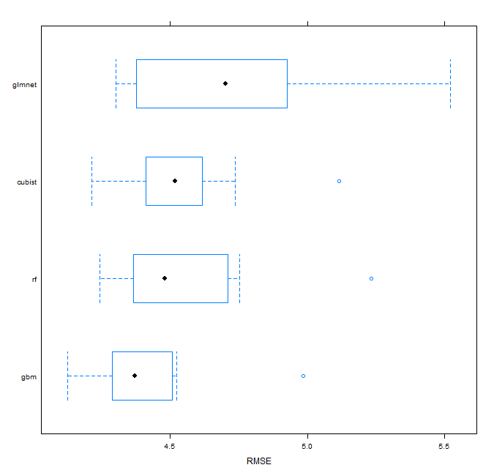
After Further tuning the parameters
After tuning parameters
Model | RMSE | Rsquared
gradient boosting(gbm) | 4.42 | 0.76
random forest(rf) | 4.54 | 0.74
cubist | 4.55 | 0.74
glmnet | 4.73 | 0.72

Slide 11
Predict and evaluate accuracy and finalize the model
Algorithm | Trained Model |  | After Predicting with test data
Model | RMSE | Rsquared | RMSE | Rsquared
gradiant boosting(gbm) | 4.42 | 0.76 | 7.9 | 0.77
random forest(rf) | 4.54 | 0.74 | 4.48 | 0.75
cubist | 4.55 | 0.74 | 4.53 | 0.75
glmnet | 4.73 | 0.72 | 4.74 | 0.72
After making the predictions though gbm did pretty good with training data with RMSE of 4.42 value, with test data set RMSE value is very poor. And random forest seems to be good with improved accuracy on the test data set with a value of 4.48. ‘Cubist’ and ‘lm’ perform approximately similarly on the test dataset as on the training dataset.

Slide 12
Client usage and benefits
How would Client benefit by predicting the Call Volume.
Be prepared for inclement weather conditions and respond faster to customer for assistance
Reduce the wait time and response time
CSAT scores can be improved and customer acquisition can be improved.
“Expect the best. Plan for the worst” – customer loyalty

Slide 13
Next Steps
Add additional variables to improve the model prediction
1). Traffic Volume
2). Construction Data
3). Handle the outliers and tag the missing data equally
Apply further transformation techniques and improve the Accuracy of the model so that we can predict the call volume.

